Slide 1


01
The Future of Human Machine Interface
What's in store for us?

Slide 2
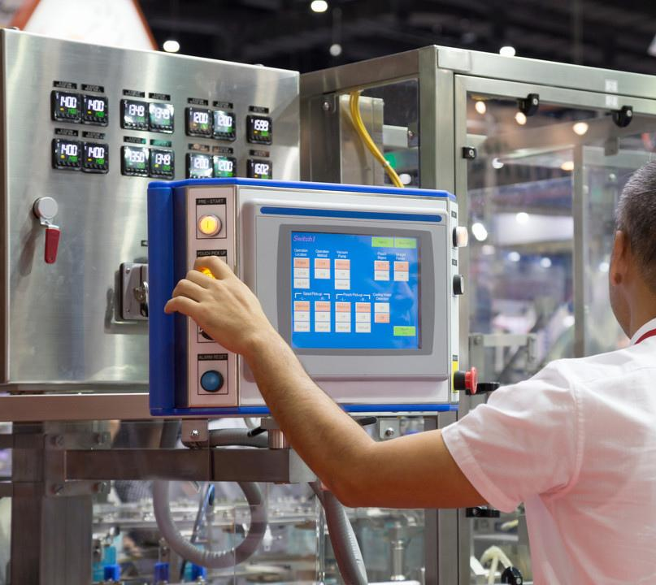
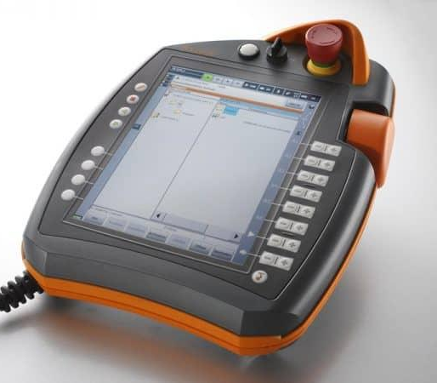
02
HMI
is an important part of applications.

Slide 3



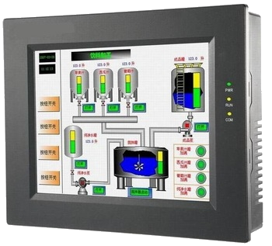
03
But you can't expect things to stay the same.
Limitations of Traditional HMI - Lack of screen space.
Cramped UI.
Lack of information .
Limited or No Portability.
Expensive. Cumbersome.
Outdated looks.

Slide 4
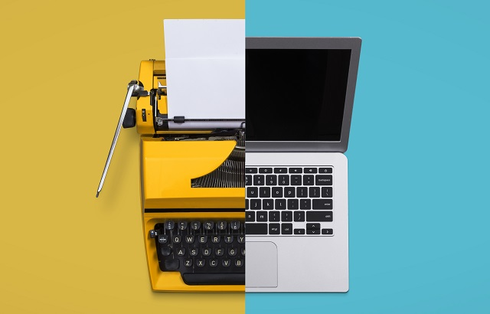
04
HOW CAN WE MAKE THINGS BETTER?

Slide 5
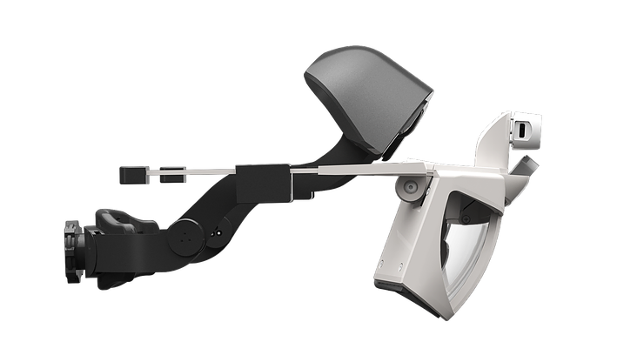
RISE OF
AUGMENTED REALITY
06
Augmented reality is the result of using technology to superimpose information on the world. It adds to the reality rather than replacing it. This opens the opportunity to place more information around the user.
Think of it standing in Times Square! Technologies like S.L.A.M. (simultaneous localization and mapping) and depth tracking along with recent developments in Vision processing and shrinking of silicon has made this technology a reality.
Project NorthStar is an open source AR headset that always uses a Leap Motion sensor and an Intel T265 sensor to track hands and user’s position.

Slide 6
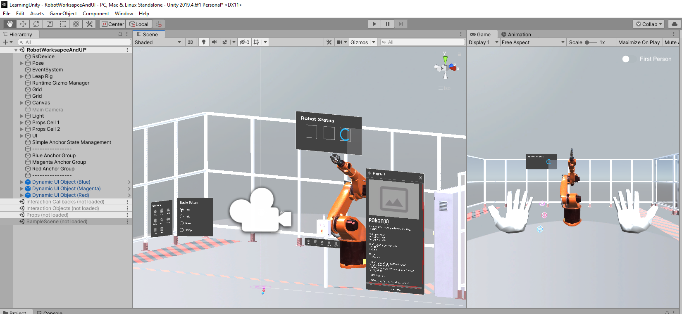
The world around you is a Screen
07
An AR headset solves a lot of problems by making the screen size ‘infinite’.
Since a user is always looking at a screen, there are no limitations as to what we can show them.
We can make the UI compact as an HMI or extensive as a Windows application.

Slide 7
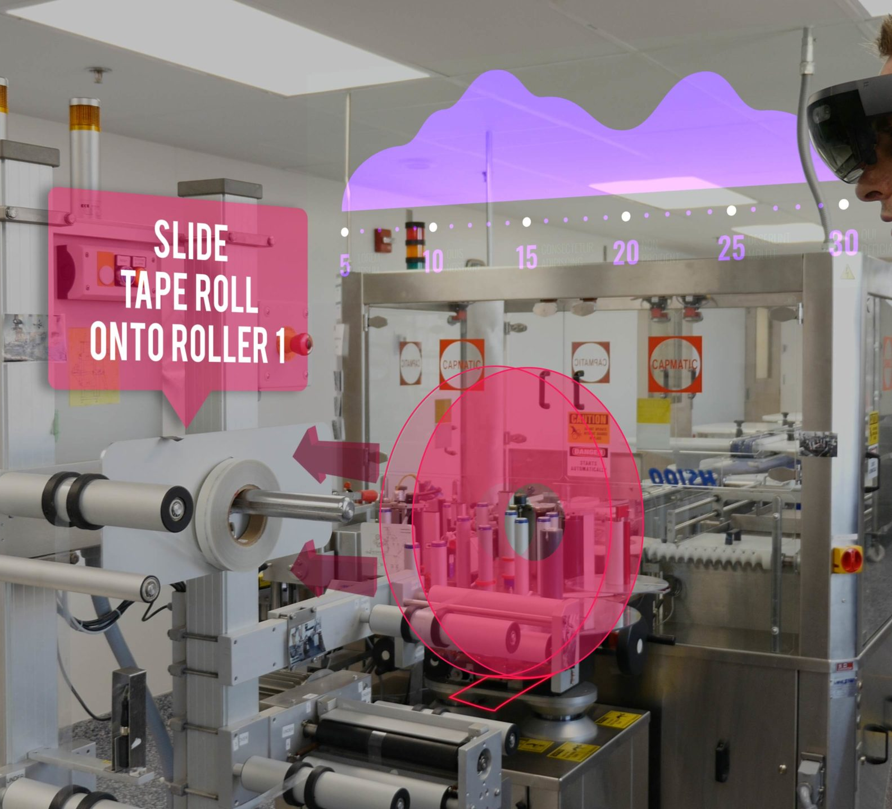
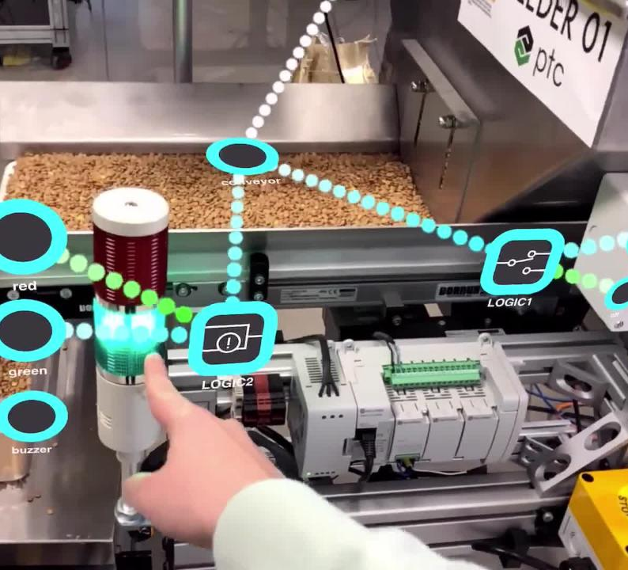
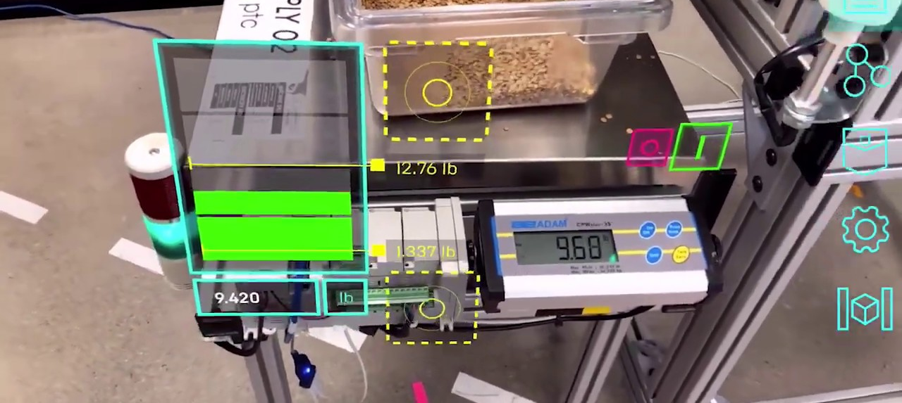
08
Lay UI all over a machine
Presentations are communication tools that can be used
as demonstrations, lectures, speeches, reports, and more.
It is mostly presented before an audience.

Slide 8
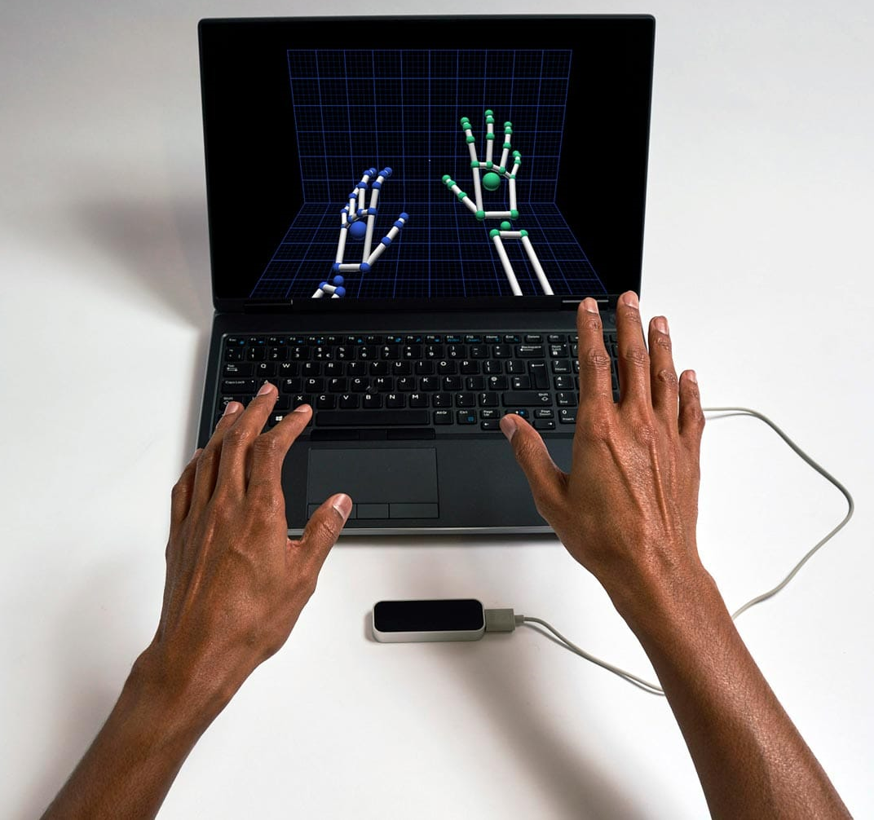
Control using your hands
Interact with the UI using your hands. Power image processing by the Leap Motion sensor

Slide 9

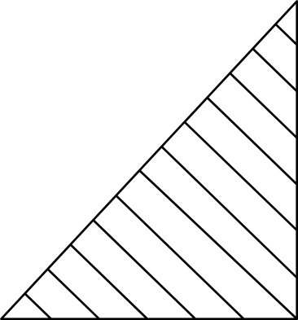
Presentations are communication tools that can be used as demonstrations, lectures, speeches, reports, and more. It is mostly presented before an audience. It serves a variety of purposes, making presentations powerful tools for convincing and teaching.
WHOLE BRAIN EMULATION
Presentations are communication tools that can be used as demonstrations, lectures, speeches, reports, and more. It is mostly presented before an audience.

Slide 10


11
AUTO TRANSLATION
Presentations are communication tools that can be used as demonstrations, lectures, speeches, reports, and more.
It is mostly presented before an audience.

Slide 11
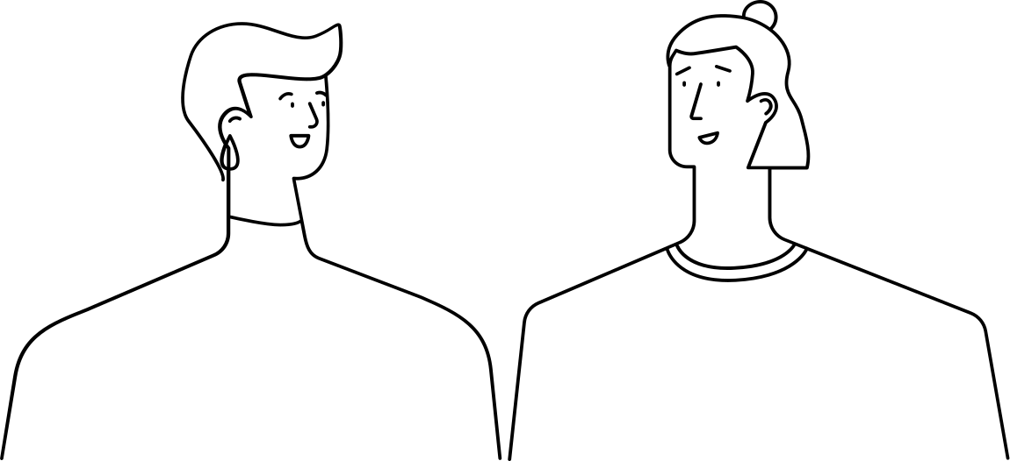
PROLIFERATION OF CHAT BOTS
Presentations are communication tools that can be used as demonstrations, lectures, speeches, reports, and more.
It is mostly presented before an audience.

Slide 12

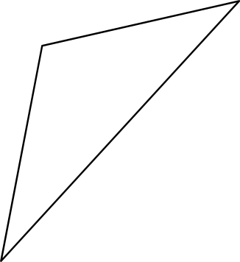
13
DIGITAL TELEPATHY
Presentations are communication tools that can be used as demonstrations, lectures, speeches, reports, and more.
It is mostly presented before an audience.
Presentations are communication tools that can be used as demonstrations, lectures, speeches, reports, and more.
It is mostly presented before an audience.

Slide 13
14
Presentations are communication tools that can be used as demonstrations, lectures, speeches, reports, and more. It is mostly presented before an audience. It serves a variety of purposes, making presentations powerful tools for convincing and teaching.
AN ERA
OF VIDEO CONFERENCING
Presentations are tools that can be used as demonstrations, lectures, speeches, reports, and more. It is mostly presented before an audience.

Slide 14
Electric communication
will never be a substitute for
the face of someone who with their soul encourages another person to be brave and true.
Charles Dickens

